Slide 1
CSCI 566: Deep Learning and Its Applications
Jesse Thomason
Lecture 10: Deep Reinforcement Learning

Slide 2
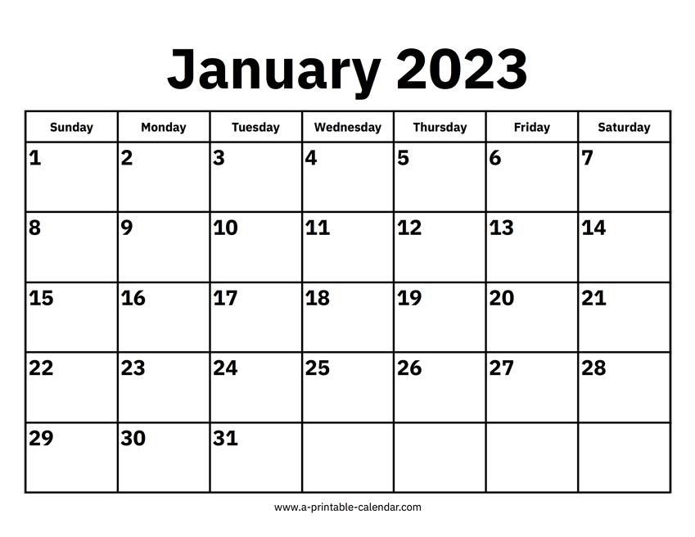
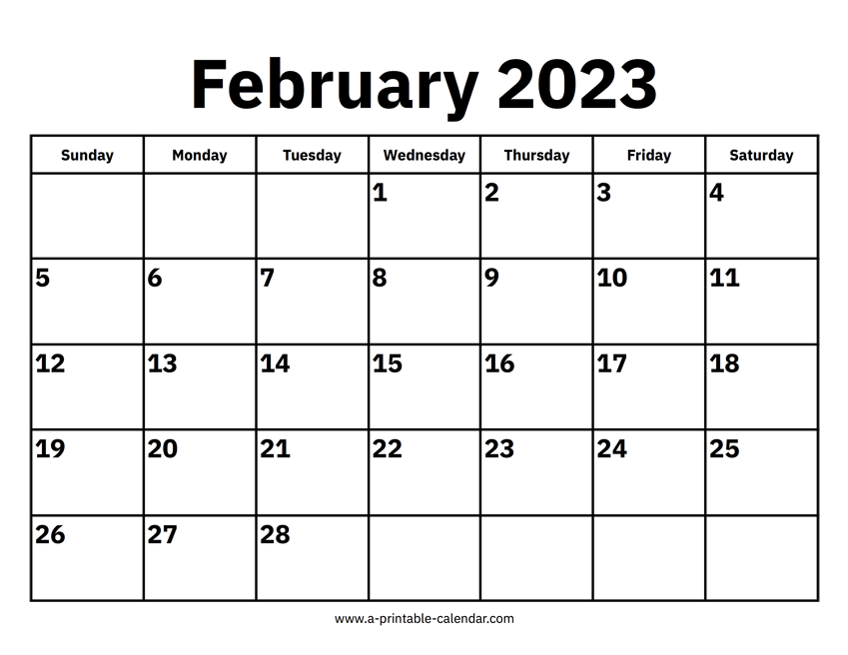
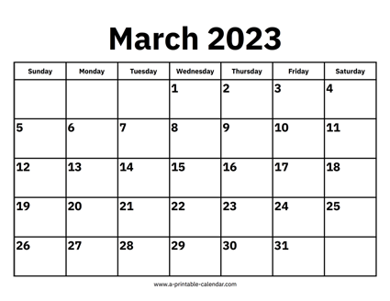
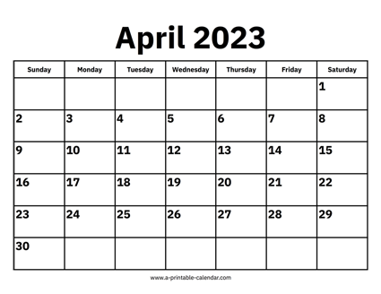


CSCI 566 Roadmap
Module 1: Neural Network Basics
Module 2: Deep Learning Applications
Module 3: Advanced Topics in Deep Learning

Slide 3
[April 7] Endgame Deliverables
Paper Roleplaying Breakout Sessions | April 7, April 14
Final Project Presentations | April 21, April 28
Project Final Report | May 3

Slide 4
Overview of Today’s Plan
Course organization and deliverables
Any questions before we move on?
Lecture 9 Recap
Deep Reinforcement Learning
April 7 Project Roleplaying Breakouts

Slide 5
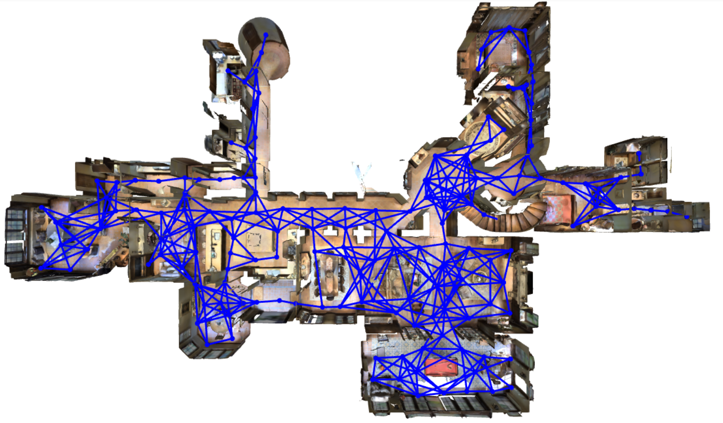
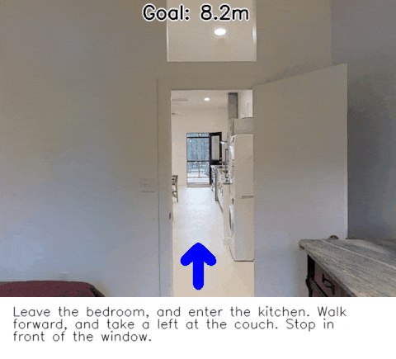
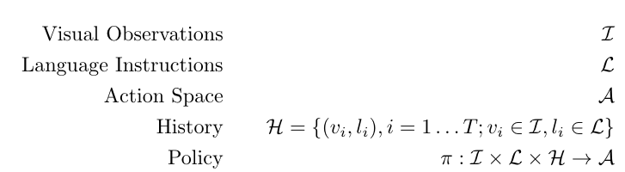
Vision-and-Language Navigation (VLN)
https://bringmeaspoon.org/

Slide 6
World Actions and Consequences
Agents perform sequence prediction
We are no longer taking in input and producing a single output
E.g., retrieval of an image from language
Want to learn a policy 𝛑(a|s) from states to actions
We are taking in observations (e.g., language and vision) and producing one action at a time that causes new observations we can consider; our state is estimated by observations
Open-loop: Produce whole sequence at once
Closed-loop: Consider observations after each action

Slide 7
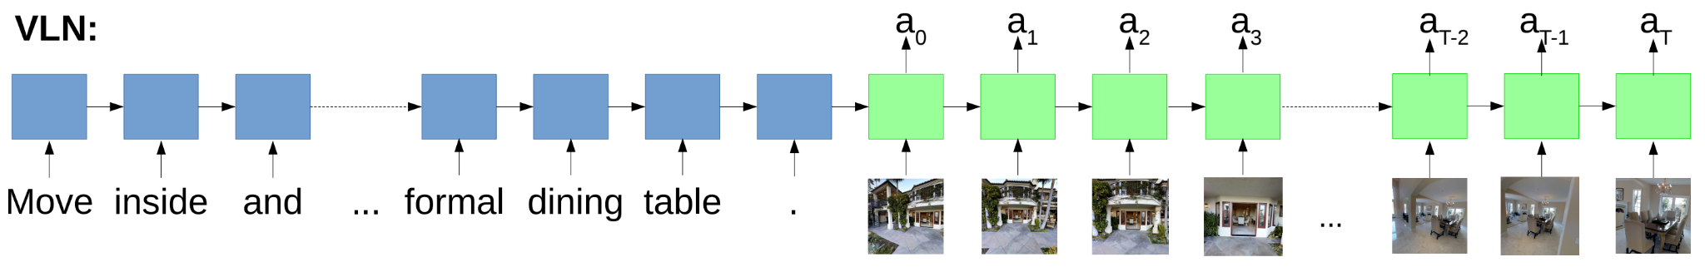
Vision-and-Language Navigation with LSTM
https://bringmeaspoon.org/

Slide 8
Vision-and-Language Navigation with LSTM
The resulting LSTM is a policy from states represented as history so far, image observations, and language instructions to actions in the environment
With training data, this is just supervised learning still; in this community you’ll also see this called imitation learning
https://bringmeaspoon.org/

Slide 9


Vision-and-Language Navigation with LSTM

Slide 10
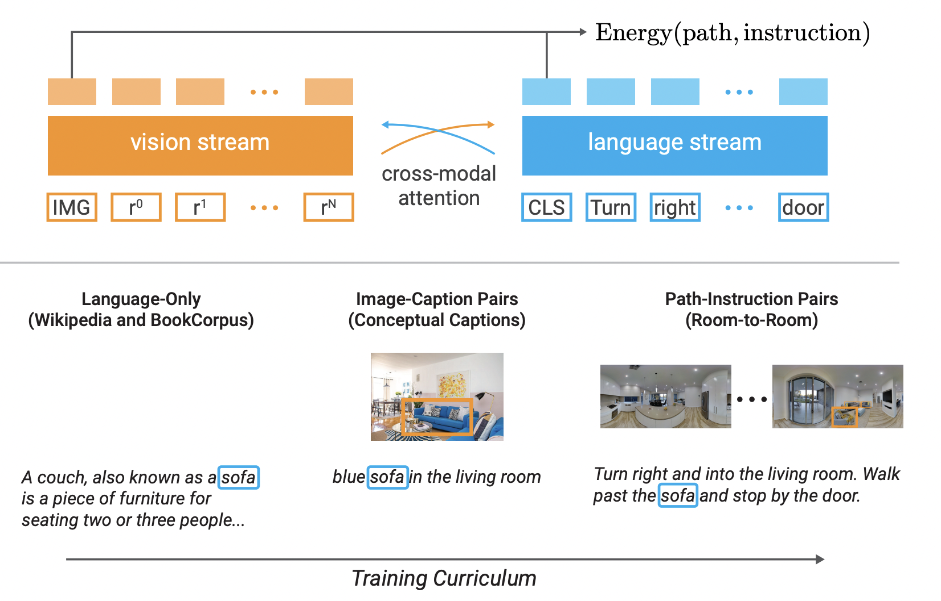
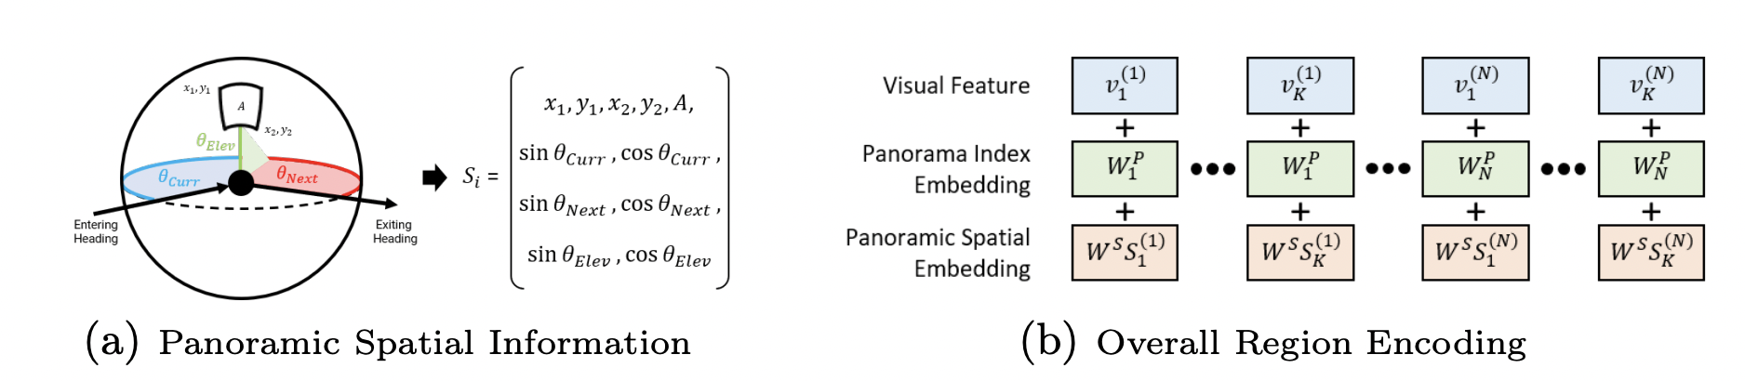
Language and Vision and “Time”
Improving Vision-and-Language Navigation with Image-Text Pairs from the Web

Slide 11
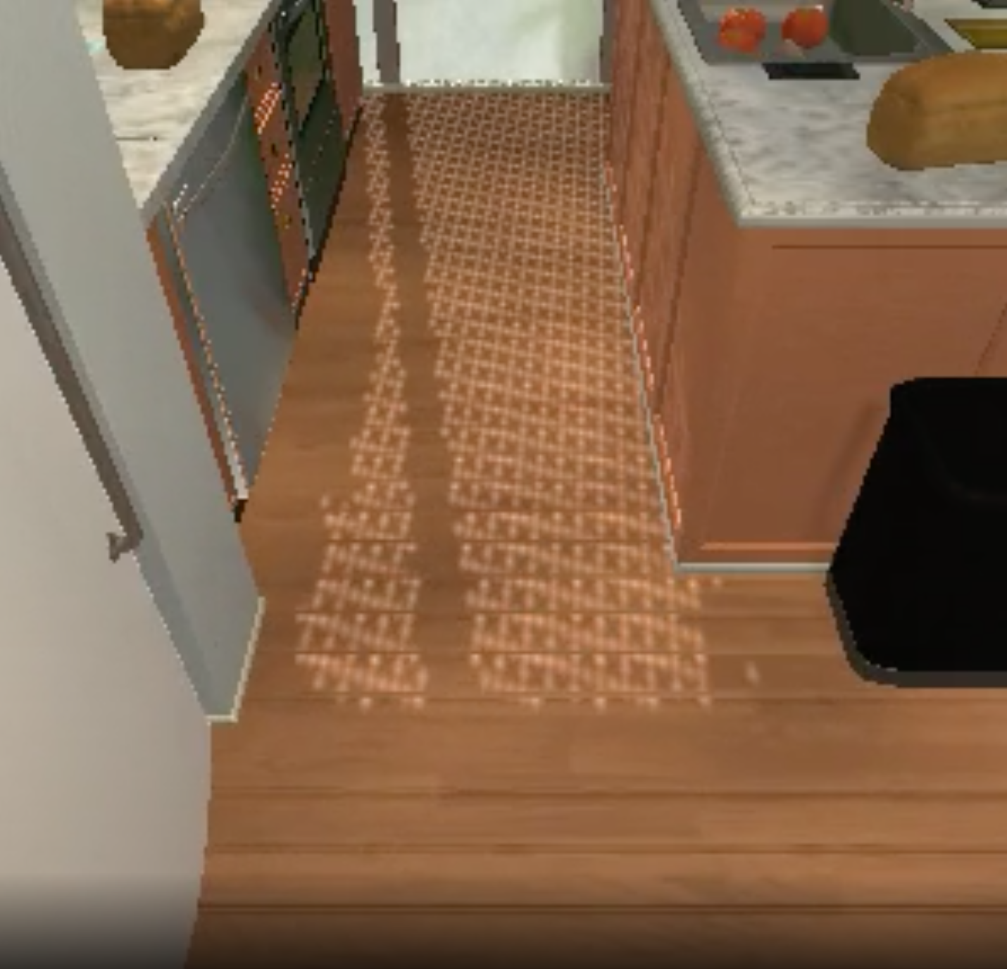
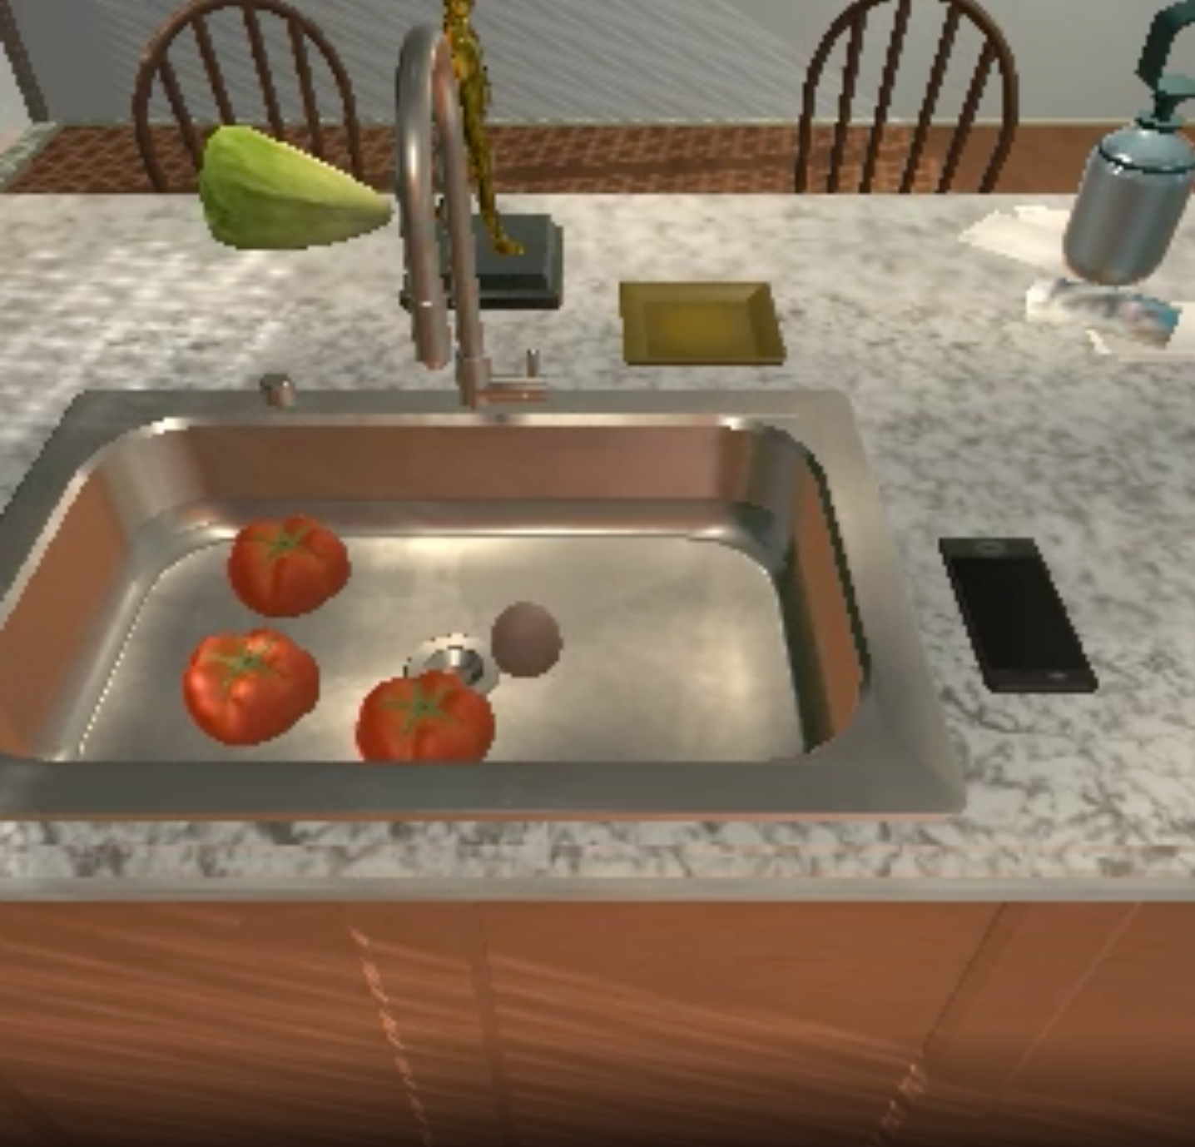
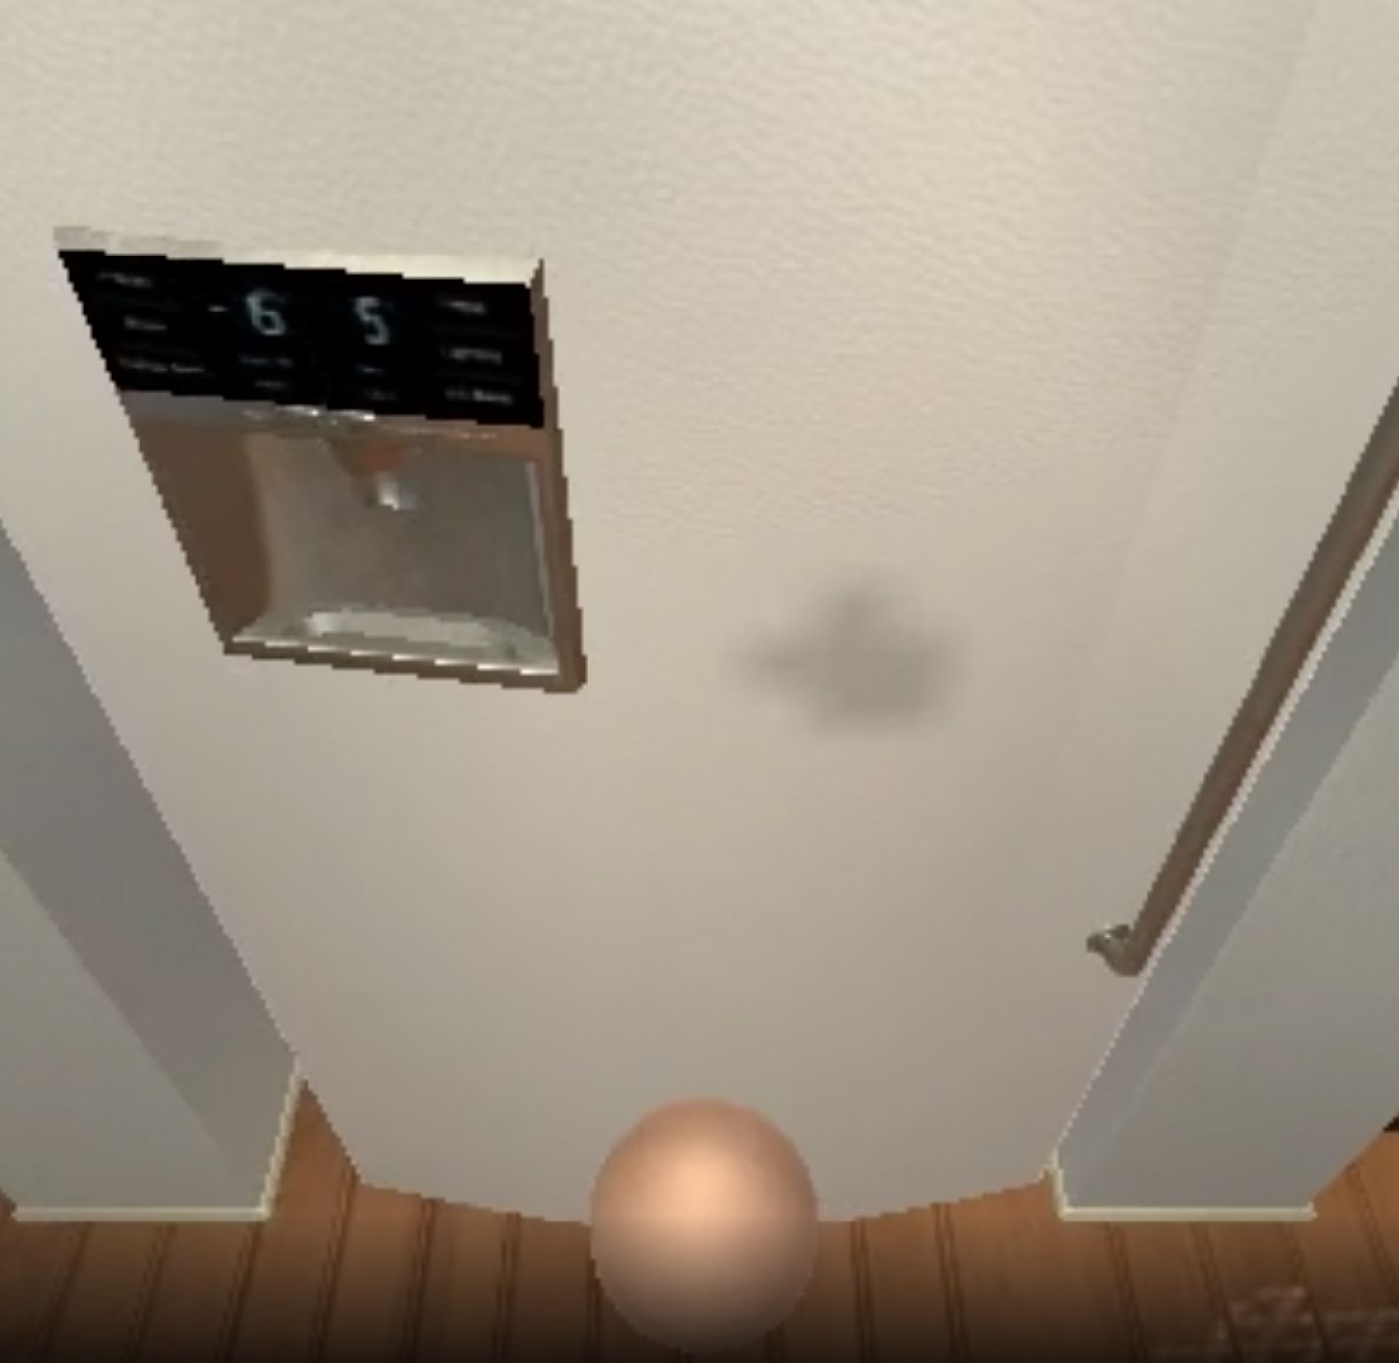
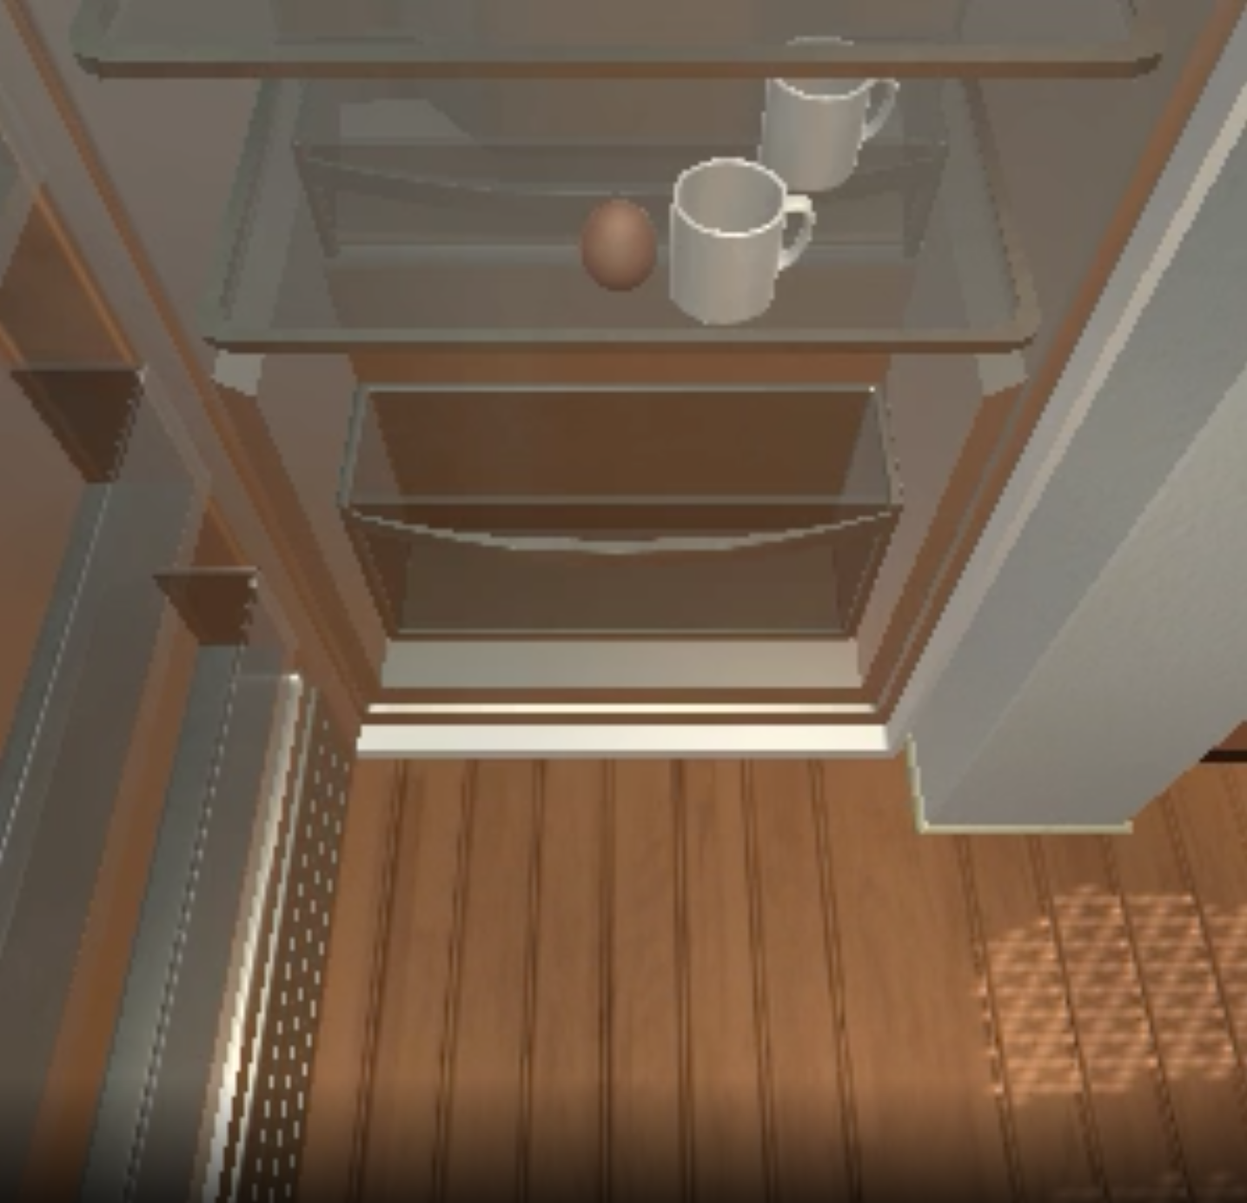
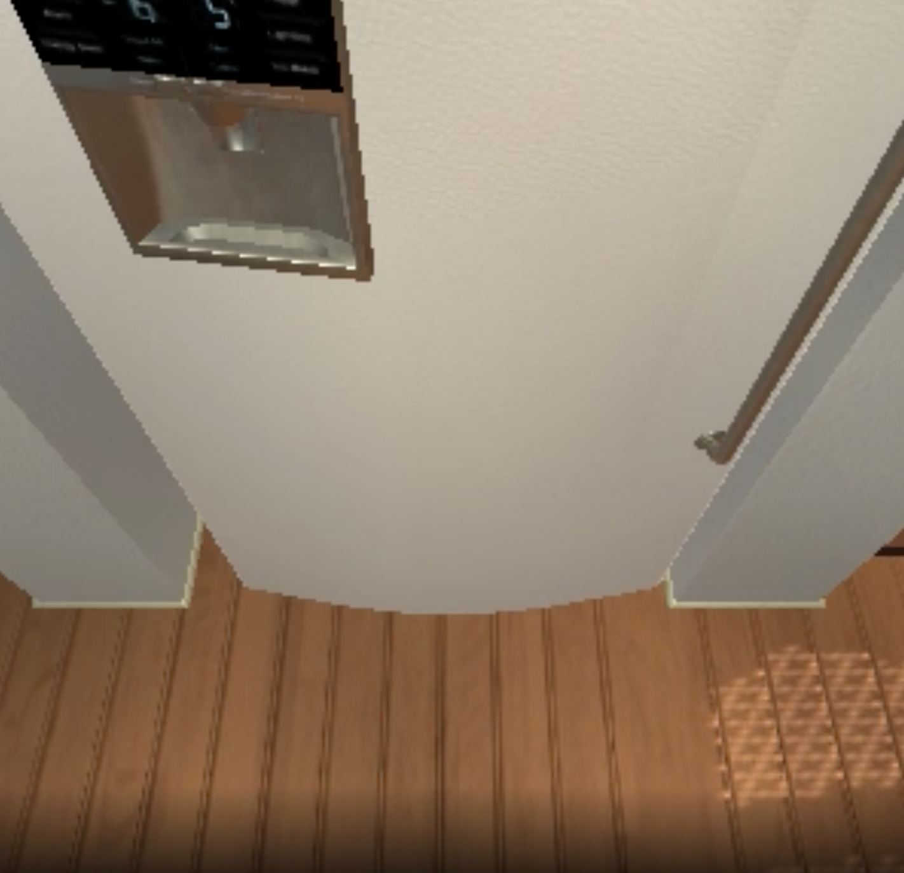
The quality of your learned state can be crucial
Forward
Pickup
Open
Close
Open
Pickup
Action Pred
Action Pred
Action Pred
Action Pred
Action Pred
Action Pred
RNN
RNN
RNN
RNN
RNN
RNN
{inst text}
{inst text}
{inst text}
{inst text}
{inst text}
{inst text}

Slide 12
Without States, Our Transformer has to Learn So Much!
Forward
Pickup
Open
Close
Open
Pickup
Transformer
Transformer
Transformer
Transformer
Transformer
Transformer
{inst text}
{inst text}
{inst text}
{inst text}
{inst text}
{inst text}

Slide 13
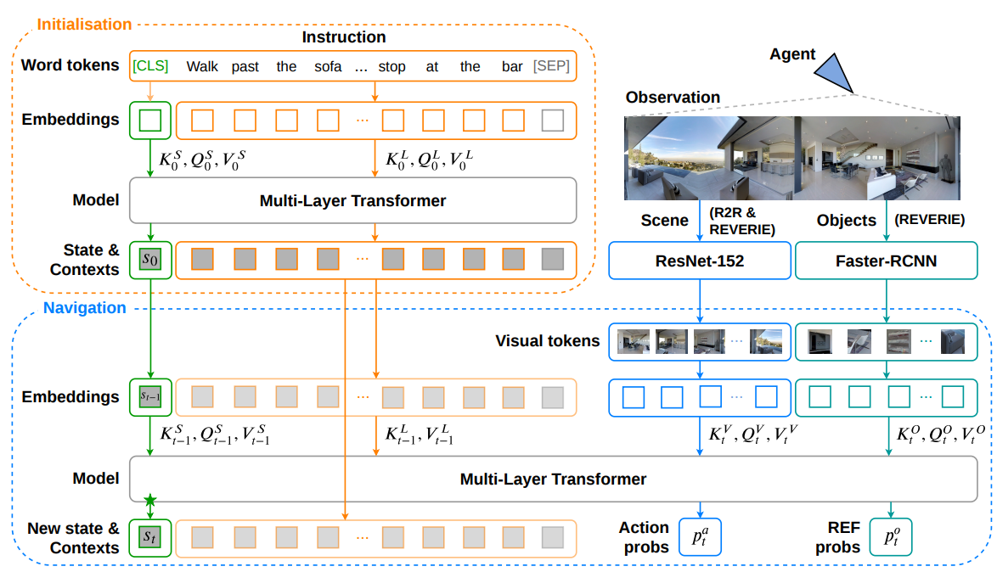
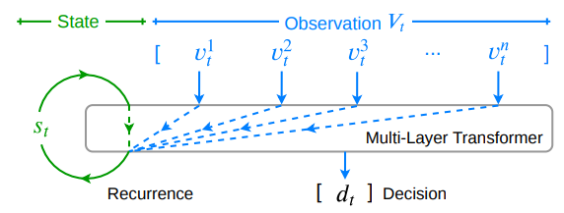
Stateful Transformers: VLN
https://arxiv.org/abs/2011.13922

Slide 14
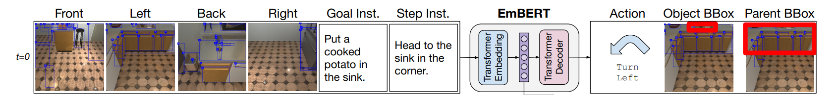
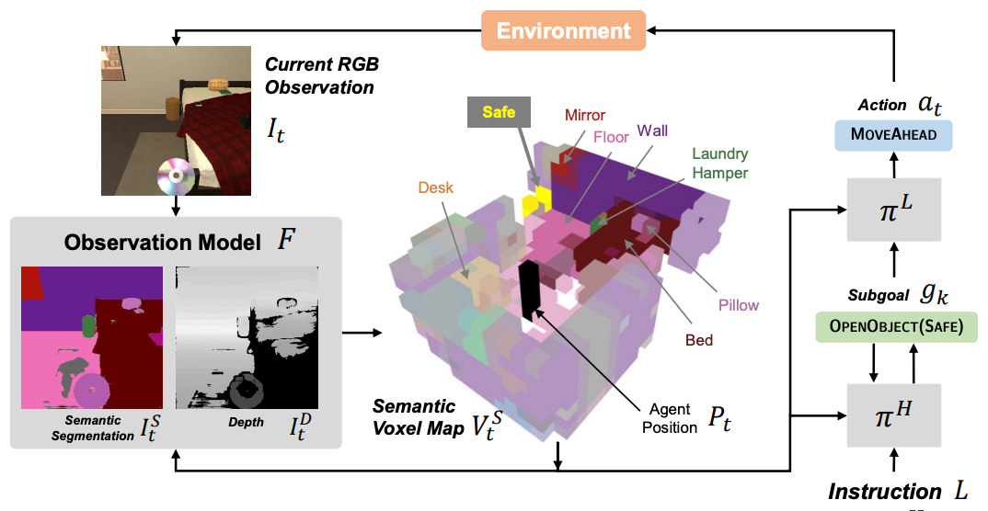
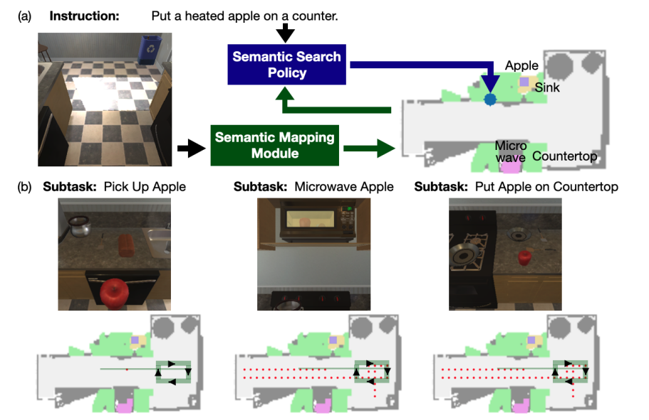
Implicit and Explicit States
https://arxiv.org/abs/2108.04927 ; https://arxiv.org/abs/2107.05612; https://arxiv.org/abs/2110.07342

Slide 15
Deep Learning for Agents
So far, we’ve talked about situations where we have demonstrations available as training data
Enables us to perform learning from demonstrations / imitation learning / supervised learning
What if we have no demonstrations, just a binary signal that tells us something like “yep, you completed the goal” or “nope, it’s not done yet”?
Then we move into the realm of reinforcement learning

Slide 16
Overview of Today’s Plan
Course organization and deliverables
Lecture 9 Recap
Any questions before we move on?
Deep Reinforcement Learning
April 7 Project Roleplaying Breakouts

Slide 17
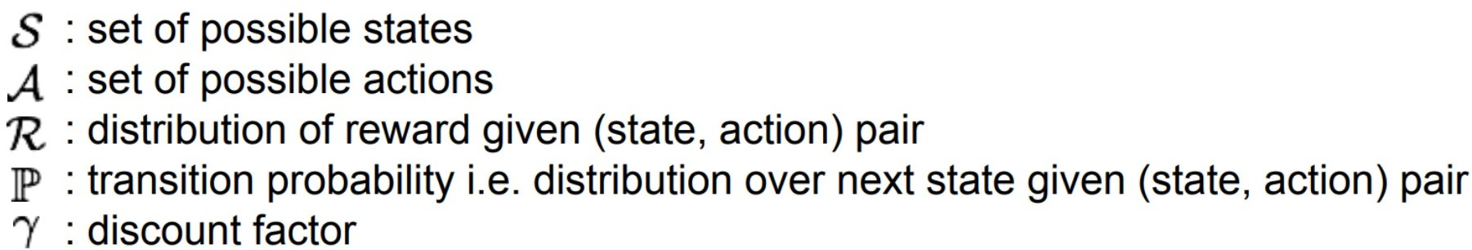
Markov Decision Process with Rewards
MPD assumption: the state captures everything we need to know about what the optimal action should be
Note rewards could be defined for every (state, action)
In practice, we’ll need to estimate the quality of states, state-action pairs, etc., especially when reward is sparse
Note that we allow for a probabilistic transition function

Slide 18
Markov Decision Process with Rewards
state
reward
World
Agent Policy
Goal: learn a policy that maximizes cumulative reward
action

Slide 19
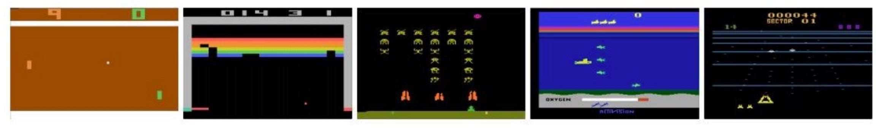
Example - Atari Games
Objective: Win the game (with scores as high as possible)
State?
Pixels on the screen completely determine current state
Actions?
Game controls (e.g. U, D, L, R, Shoot)
Reward?
Score delta between t-1 and t for action taken at time t-1

Slide 20
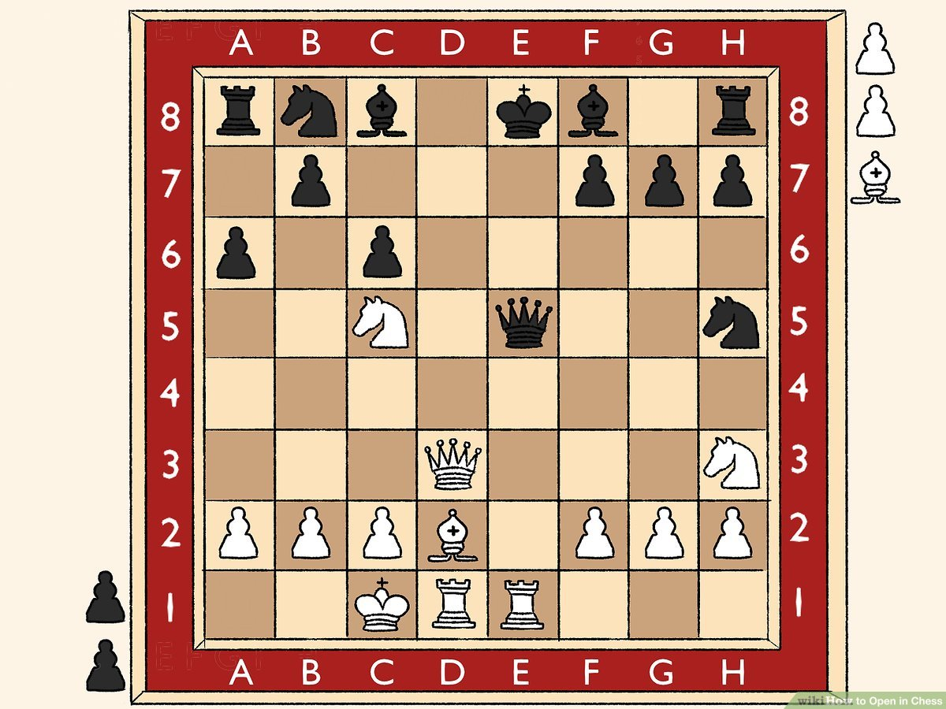
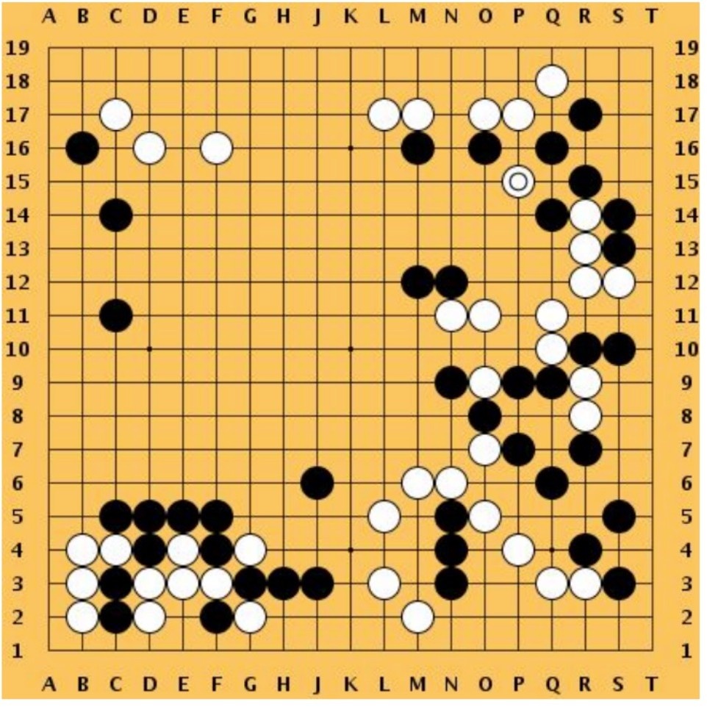
Example - Chess / Go
Objective: Win the game
State?
Positions of game pieces both on and off the board
Actions?
Admissible game moves
Reward?
Sparse: 1 if win, -1 if lose. Dense: heuristics (e.g., capture)

Slide 21
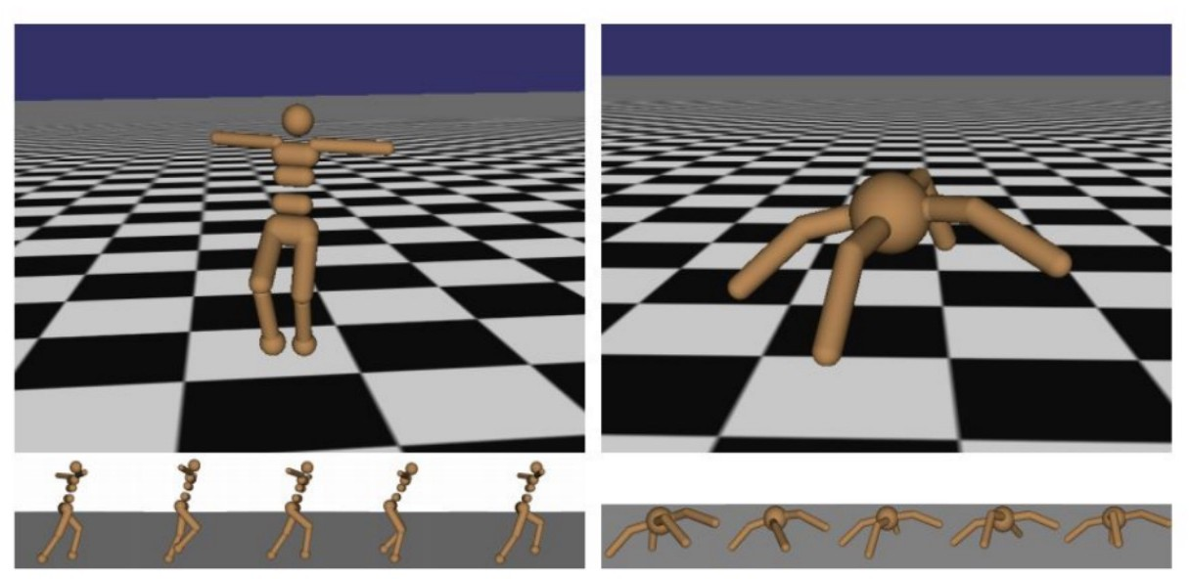
Example - Control
Objective: Cover ground by walking
State?
Position and angles of the joints
Actions?
Torques applied on joints
Reward?
Increases in distance from origin at each timestep

Slide 22
Markov Decision Process with Rewards
At t=0, get initial state s₀
Get action a_{t} from policy 𝝿(s_{t};θ)=a_{t}
World samples next state s_{t+1} from transition function P(s_{t},a_{t})=s_{t+1}
Agent receives reward r_{t}=R(s_{t},a_{t})
Can also be defined as r_{t}=R(s_{t+1})
state
reward
World
Agent Policy
action

Slide 23
Markov Decision Process with Rewards
Optimization Goal: learn policy parameters θ to maximize cumulative discounted reward
For a given trajectory with sequence of rewards r: 𝝨_{t}ɣ^{t}r_{t}
state
reward
World
Agent Policy
action

Slide 24
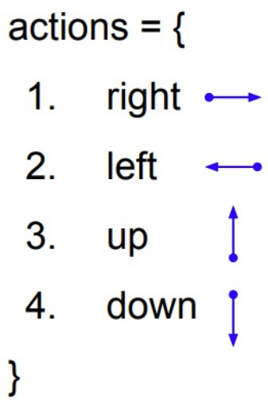
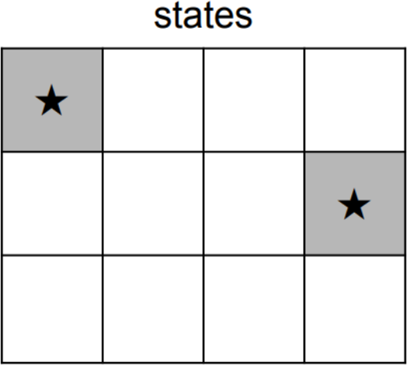
Simple MPD Example And Solution
Transition?
Deterministic
Rewards?
+10 for reaching star
-1 for each action
Objective: Reach stars (either one) with least number of actions

Slide 25
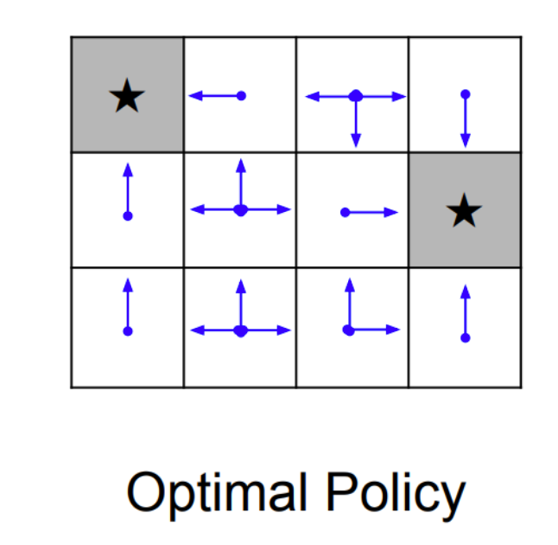
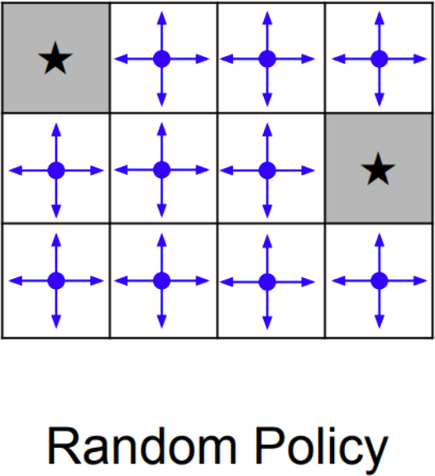
Simple MPD Example And Solution

Slide 26
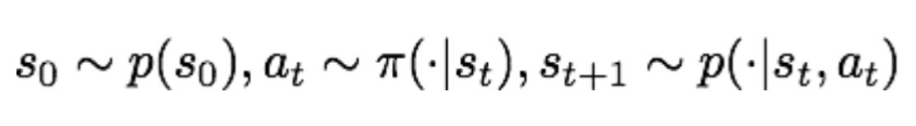
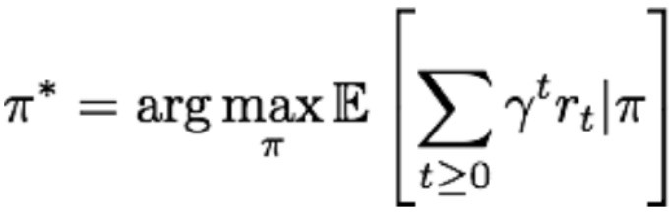
Markov Decision Process with Rewards
state
reward
World
Agent Policy
action

Slide 27
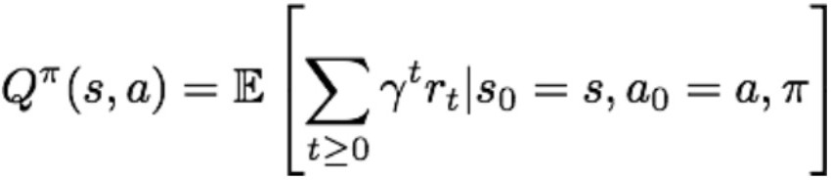
Seeking An Optimal Policy
Suppose we have a set of sampled trajectories
A trajectory is defined by the tuple (s, a, r) through time
E.g., <(s₀, a₀, r₀), (s₁, a₁, r₁), (s₂, a₂, r₂), …>
One approach we can take is to estimate the quality of (state, action) pairs in terms of the eventual expected reward
Q-value function:
The expected cumulative reward if following the policy at state s, taking the action a

Slide 28
Seeking An Optimal Policy
Value Based (e.g., Deep Q-Network)
Learn Value Function
Implicit Policy
Policy Based (e.g., guided policy)
No Value Function
Directly Learn Policy
Value
Policy
Actor-Critic
Learn Value Function
Learn Policy
Actor- Critic
Value-Based
Policy-Based

Slide 29
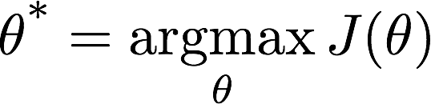
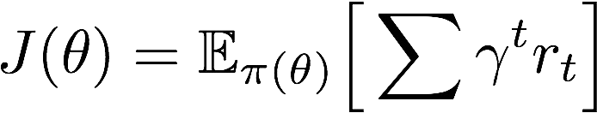
Seeking An Optimal Policy
Valued-based: a function that measures how valuable action a is at state s
Indirectly yields a policy
Policy-based: a function that measures the probability of action a leading to the best final outcome from a given state s
Directly yields a policy
Value
Policy
Actor- Critic
Value-Based
Policy-Based

Slide 30
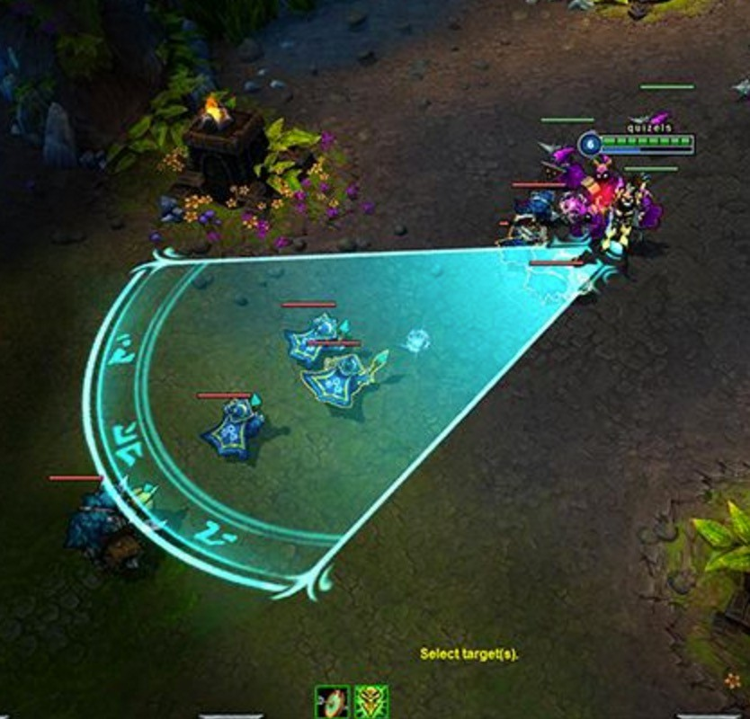
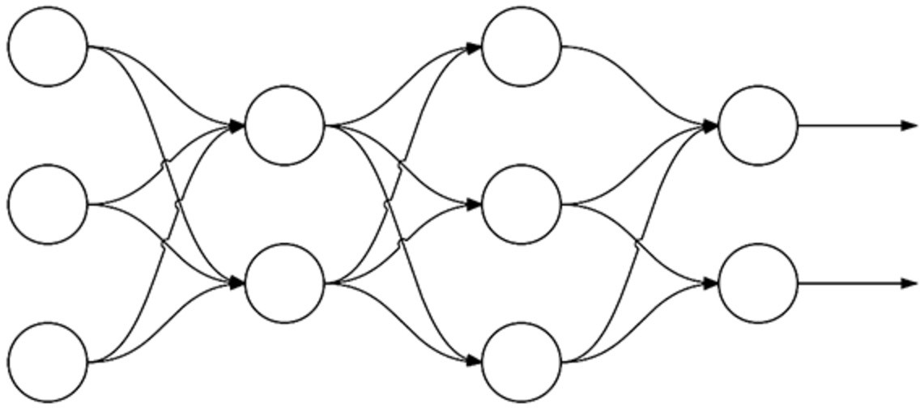
Supervised Learning versus Policy Gradient
Forward Pass
log probabilities of actions
-1.2 -0.36
Loss
Gradients 1.0 0
Ground truth
Backward Pass
Learn: 𝝿: S → A for 𝝿 parameterized by 𝝷
Deep Reinforcement Learning: Pong from Pixels

Slide 31
Supervised Learning versus Policy Gradient
Forward Pass
log probabilities of actions
-1.2 -0.36
Sampled Action
Loss
Gradients 0 -1.0
Backward Pass
Learn: 𝝿: S → A for 𝝿 parameterized by 𝝷
Eventual Reward= -1.0
Deep Reinforcement Learning: Pong from Pixels

Slide 32
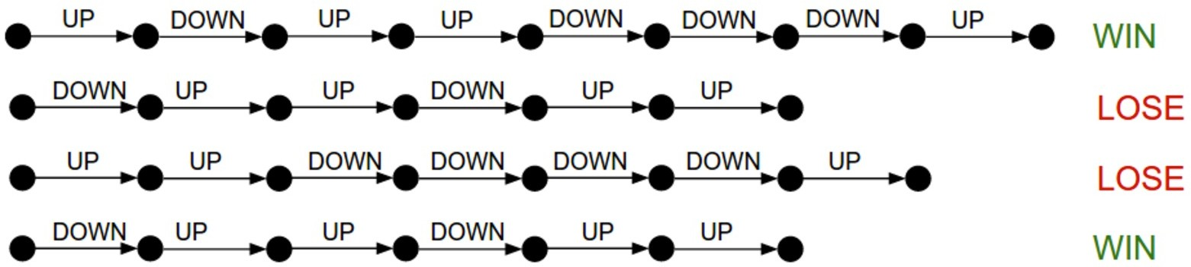
Policy Gradient
Given a (possibly random) policy, run it for several iterations
See what sticks!
Upweight (state, action) transitions that lead to high eventual reward, downweight others
Policy Gradients
Deep Reinforcement Learning: Pong from Pixels

Slide 33
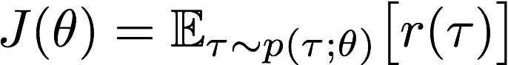
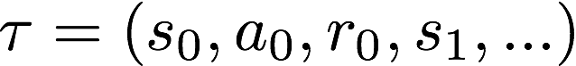
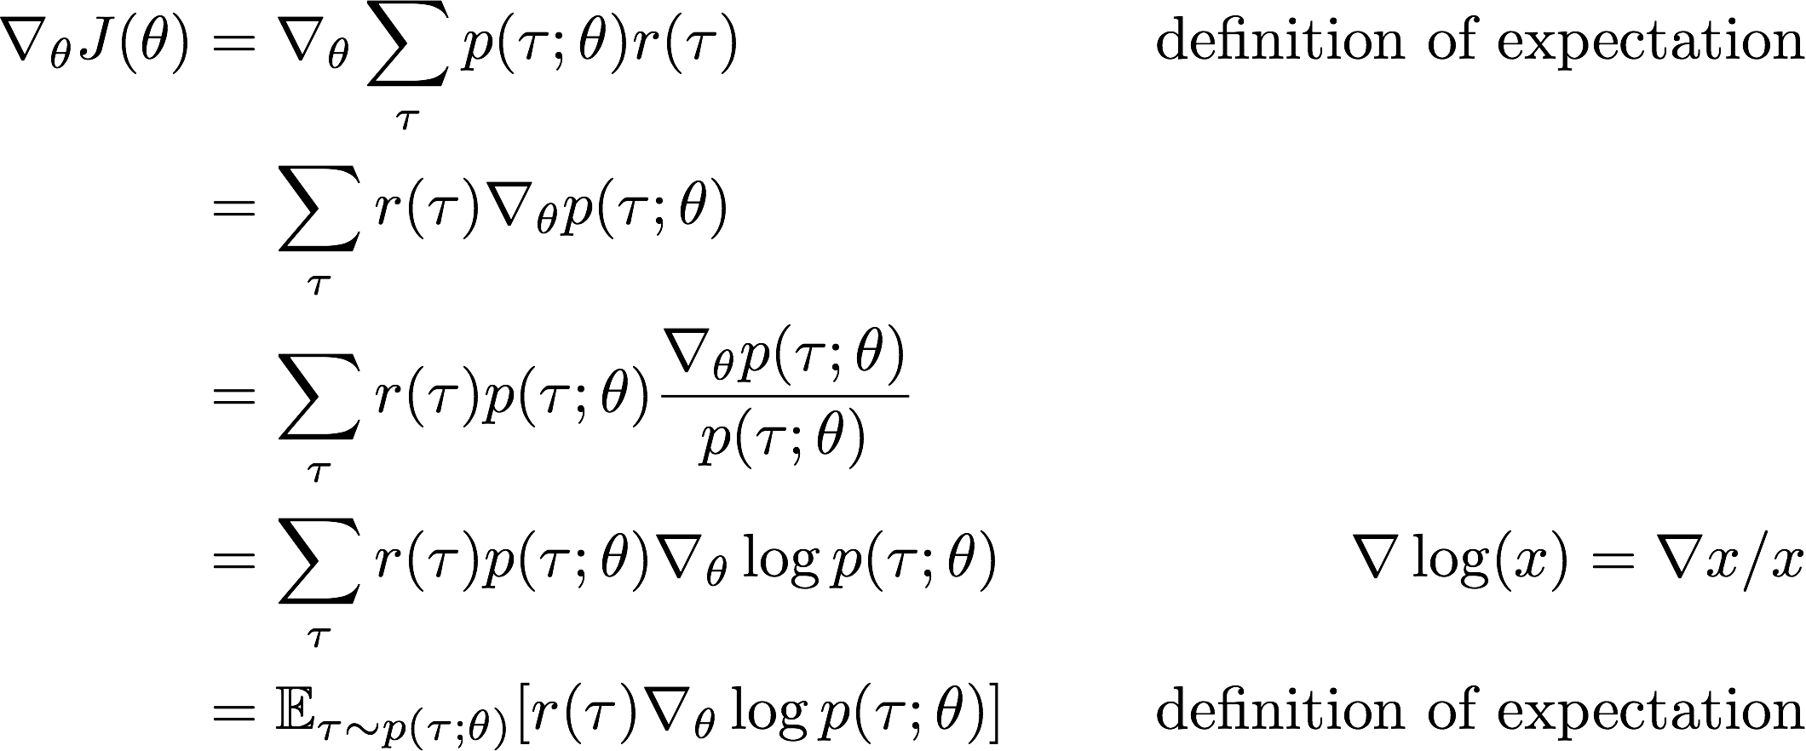
Policy Gradient
Objective to optimize:
Trajectory:
Policy Gradient Theorem:
The derivative of the expected reward is the expectation of the product of the reward and gradient of the log of the policy 𝝿_{θ}​.

Slide 34



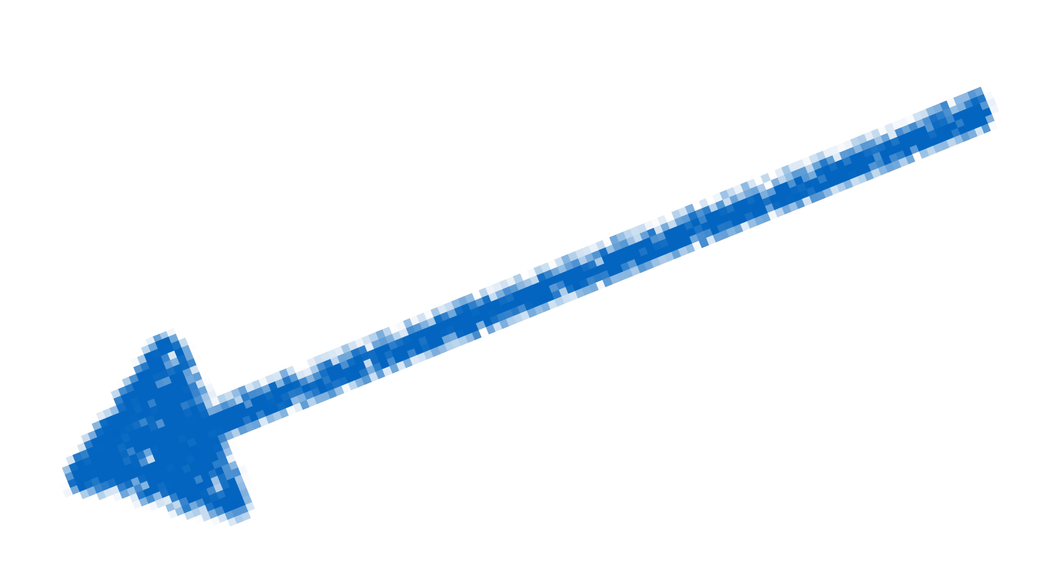


Policy Gradient
Learning step
Gradient direction (Scoring function)

Slide 35
Training a Network with Policy Gradient
Monte-Carlo Policy Gradient (REINFORCE algorithm)
Upshot:
1) Initialize a (possibly random) policy
2) Generate sample trajectories <(s, a, r)>
3) Update reward estimates at each timestep based on discounted reward from eventual result
4) Improve the policy by updating the parameters based on discounted rewards

Slide 36
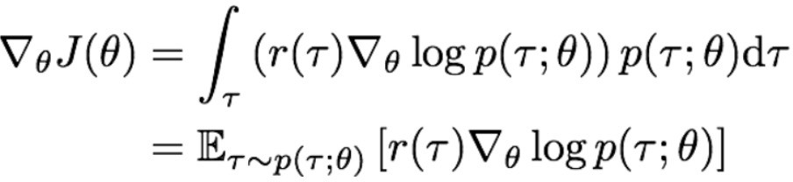

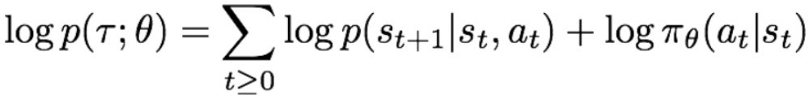
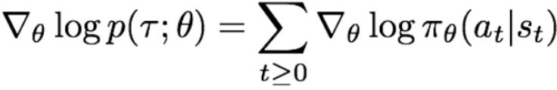
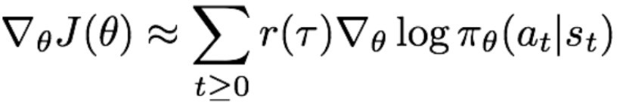
Training a Network with Policy Gradient (REINFORCE)
Write out the probability of the observed trajectory under the current policy
Differentiate with respect to policy parameters to get gradient
Note that our estimate is now independent of the true state transition function that we can’t observe directly!

Slide 37
Training a Network with Policy Gradient (REINFORCE)
Forward Pass
log probabilities of actions
-1.2 -0.36
Sampled Action
Loss
Gradients 0 -1.0
Backward Pass
Learn: 𝝿: S → A for 𝝿 parameterized by 𝝷
Eventual Reward= -1.0
Deep Reinforcement Learning: Pong from Pixels

Slide 38
Training a Network with Policy Gradient
Very general method, but policy gradients suffer from high variance and so can require a lot of samples (trajectories per policy) and iterations (policy refinements)
Policy gradient methods converge to a local minima that is often “good enough” for a task, but that convergence can be costly in terms of time and compute

Slide 39
Seeking An Optimal Policy
Value Based (e.g., Deep Q-Network)
Learn Value Function
Implicit Policy
Policy Based (e.g., guided policy)
No Value Function
Directly Learn Policy
Value
Policy
Actor-Critic
Learn Value Function
Learn Policy
Actor- Critic
Value-Based
Policy-Based

Slide 40
Seeking An Optimal Policy
Valued-based: a function that measures how valuable action a is at state s
Indirectly yields a policy
Policy-based: a function that measures the probability of action a leading to the best final outcome from a given state s
Directly yields a policy
Value
Policy
Actor- Critic
Value-Based
Policy-Based

Slide 41
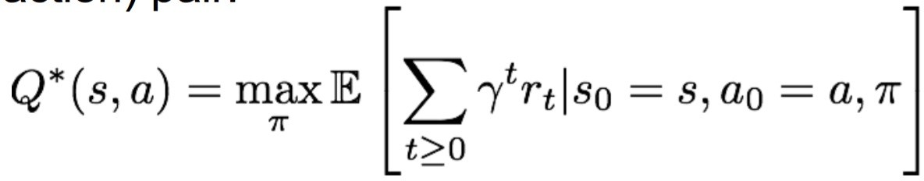
Q-value Function
Want a function that measures how valuable action a is at given state s
Optimal Q-value function:
The best expected cumulative reward at state s when taking the action a next

Slide 42
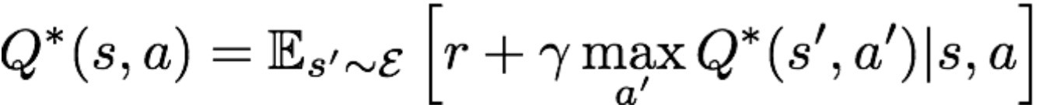
Bellman Equation
Optimal Q-value function gives maximum expected return
Such an optimal function satisfies the optimality described by the Bellman Equation:
which in a nutshell says: the highest value of a (state, action) pair is the immediate reward plus the discounted best future reward from here

Slide 43
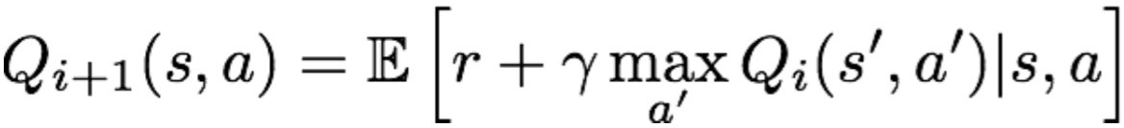
Value Iteration
Intuition: Update the Q-value function iteratively
Note similarity to Bellman Equation:
In expectation, such an iterative update will converge to the optimal estimate Q* if trajectories show us all (s, a) pairs enough times

Slide 44
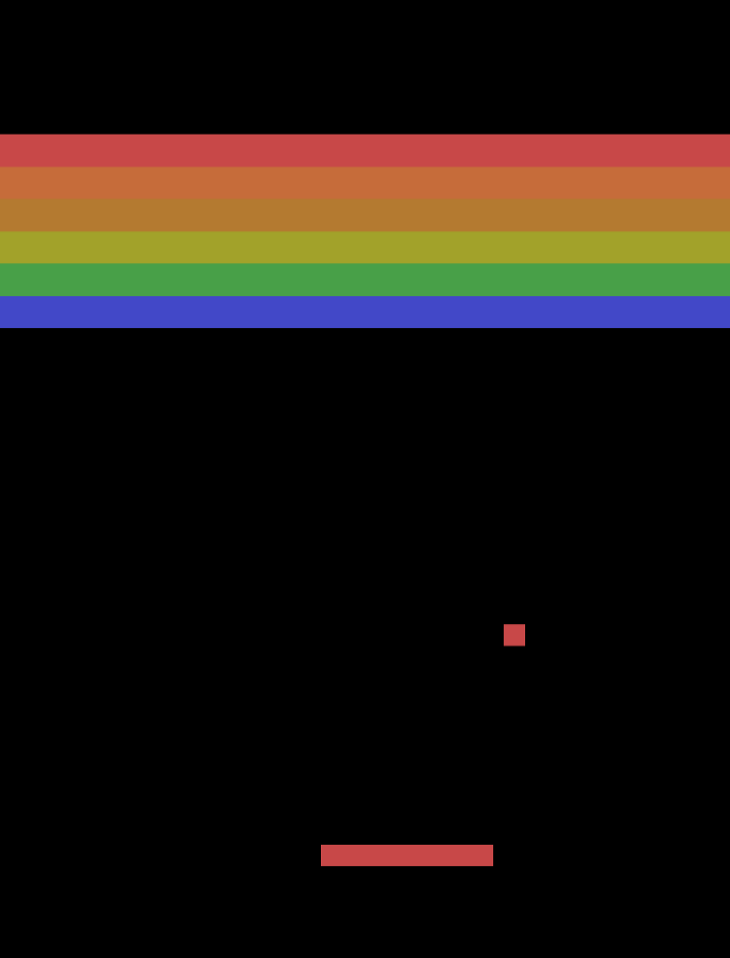


Value Iteration
Update: Q₀

Slide 45
Value Iteration
Update: Q₁

Slide 46
Value Iteration
Update: Q₂

Slide 47
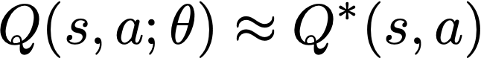
Value Iteration
Intuition: Update the Q-value function iteratively
Getting an accurate estimate Q*(s,a) for every state-action pair is intractable for continuous state/action spaces and large discrete spaces too (e.g., all possible space invaders screens)
What if we could approximate the Q function?
What’s a good way to do function approximation?

Slide 48
Training a Network with Value Iteration
Forward Pass
Action Q-value estimates
.94 .87
Note: our network here is from states to actions still; why can it model Q(s,a;𝜽)?
Backward Pass
Sharing params among action Q value estimate networks; what we’re estimating depends on the loss function

Slide 49

Training a Network with Value Iteration
Forward Pass
The Loss:
“Ground truth” Q*
Approximation
Estimate via value iteration intuition
Backward Pass
Update 𝜽:

Slide 50
Overview of Today’s Plan
Course organization and deliverables
Lecture 9 Recap
Deep Reinforcement Learning
Any questions before we move on?
April 7 Project Roleplaying Breakouts

Slide 51
Action Items for You
For those doing a Paper Roleplaying Breakout session today, turn in your 2-page paper role report by 11:59pm tonight through the gDrive submission form
If your final project presentation is on April 21st (two weeks from today), turn in your project question + multiple choice answers this week or on Friday next (April 14th)
We’ll post on Piazza to remind you about that

Slide 52
Paper Roleplaying Breakouts: April 7 [Schedule]
High-Resolution Image Synthesis with Latent Diffusion Models (Find Jesse outside THH 201)
Deep Residual Learning for Image Recognition (Virtual with Bingjie)
U-Net: Convolutional Networks for Biomedical Image Segmentation (Find Shihan in THH 201 front)
Language Model Cascades (Find Tejas in THH 201 back)
The Lottery Ticket Hypothesis: Finding Sparse, Trainable Neural Networks (Virtual with Gautam)

Slide 53
CSCI 566: Deep Learning and Its Applications
Jesse Thomason
Lecture 10: Deep Reinforcement Learning

